Slide 1
An Open Dataset of Labelled Tropical Crops.
Jade Chattergoon, Fazeeia Mohammed, Kimberley Gillette, Brittany Peters, Patrick Hosein

Slide 2
Related Works and Contributions
The authors created their own datasets from images collected from a variety of sources such as satellites, a UAV, IoT cameras, robots mobile cameras and smartphones. The collected images included crops ranging from maize, rice, sugarcane, soybeans, tomatoes, turnips and pumpkins. Most of the authors then performed either image classification, object detection, semantic segmentation or instance segmentation on the images and recorded the performance of the models.
The results of the models varied across different publications, with some performing excellently while others performed poorly. Moreover, the authors who used image classification only recorded the accuracy of the models used. It is recommended that other evaluation metrics such as precision, recall and f1 score be recorded to obtain a better idea of the models’ performance. The main contribution of the paper is a large agricultural dataset that is being made available to the public, with plans to continually expand it as research progresses.

Slide 3
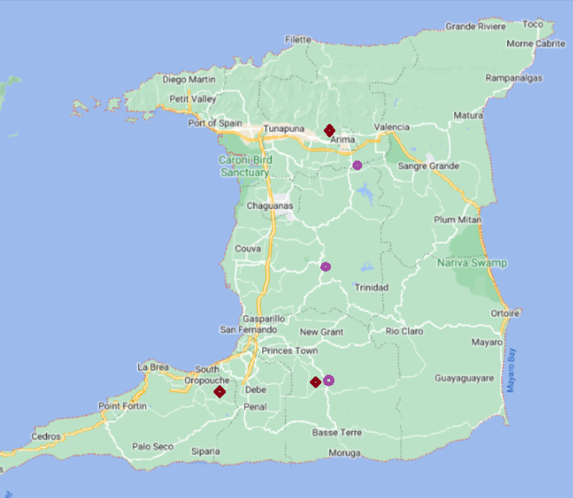
Data Collection
Data collection for this project was done using a UAV or drone.
In foreign large scale agriculture industries, drones are used to survey large areas of land quickly to detect pests, weed coverage, harvest times, nutrient deficiencies and potential crop loss.
This project was aimed at applying some of these techniques to crops grown within tropical small island developing states with the takeaway being that it can be applied to small farming situations and provide insights leading to increased crop yield in the face of climate change.
The drone was then used to take up data from October last year to June this year. The selected crops for the experiment were peppers and Pak Choi. These plants were selected because of their life cycles, distinction, and availability. It was important that the experiment be repeated during the course of the project.

Slide 4
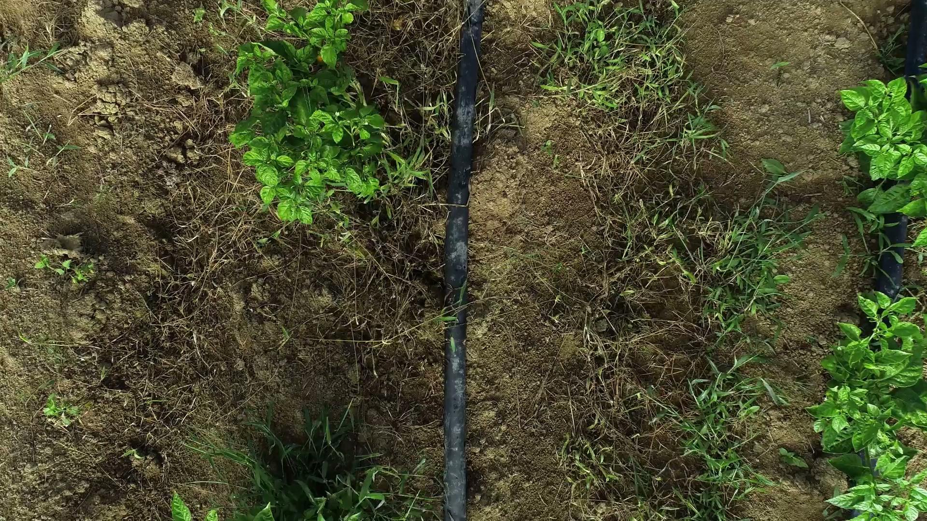
Data Collection
Data collection occurred between the wet and dry season to ensure variations between data collection. For the water stress problem this was a significant factor since climate change as affected the intensities of weather systems in the Caribbean.

Slide 5
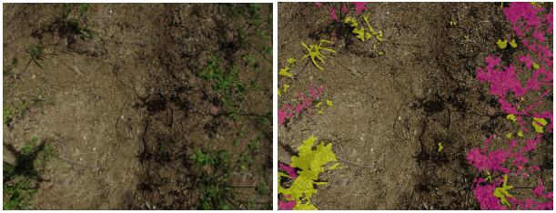
Data Labelling
Data processing was done on the videos collected from both the drone and the RGB camera. The videos were cutting up the images into frames. Frame selection was done on the basis of clarity, overlap and minimal artefacts.
The data was then handed over to various data labelling teams for image segmentation labelling. The image is a sample of weed and crop labelling done on the dataset collected.

Slide 6
Data Labelling
The images were labelled using the Image Labelling application in MATLAB. Using either the super-pixel or assisted freehand tools found in the application, the ground truth data was labelled. The images were marked using recognition of interest (ROI) labels. The healthy crops present in the image were labelled as “crops” and the weeds present in the image were labelled as “weeds”. Labelling of the images required the person labelling to manually zoom into the image at very high magnification rates to ensure accurate labelling as it was difficult to decipher between the weeds and crops without performing this step. This made the process very time consuming. The sample images were used to perform weed detection and water stress determination. The original images as well as the corresponding labelled images were loaded into the model, using their respective pixel data. The models were then trained using the original and labelled images. The performance of the models was then evaluated. The models displaying a high-performance rate were then saved and used in the construction of the mobile and web applications.

Slide 7
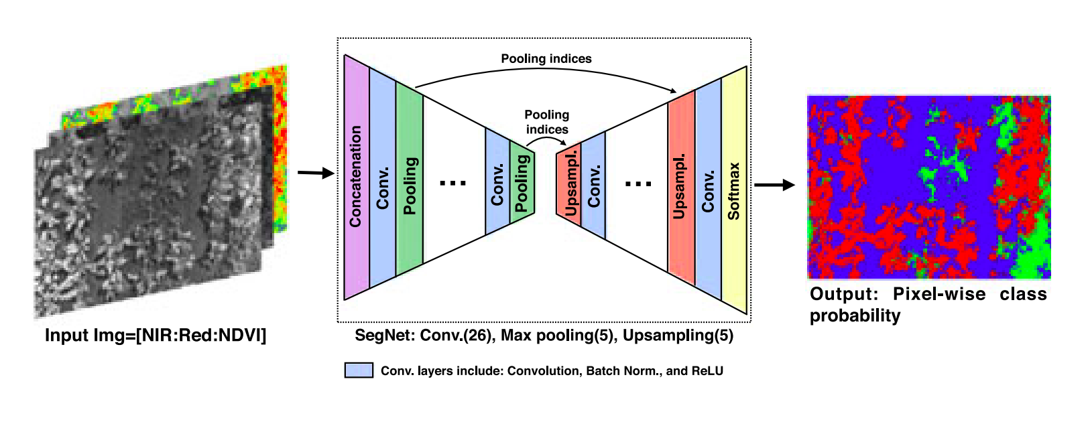
Model creation
We implemented our models on Binary and Multi-Class data. Binary data had only two labels either crop or weed, damaged or not damaged and stressed and not stressed.
The Multiclass Classification utilized minimal_weeds, moderate_weed and excessive weeds and for Developmental Stages, it utilized seedlings, two to three weeks maturity and ready to harvest.
[4] Sa, Inkyu, et al. "weednet: Dense semantic weed classification using multispectral images and mav for smart farming." IEEE Robotics and Automation Letters 3.1 (2017): 588-595.

Slide 8
Challenges
Procuring a drone was a time consuming process since the project began during COVID. The numerous restrictions and lockdowns at that time made data collection a difficult task.
Drones that can exceed a specified altitude require mandatory training to fly within Trinidad and Tobago. The drone purchase required the use of a broker to clear the drone through Customs which was also a time-consuming task.
Additionally, for every drone flight, permissions had to be pre-approved by the TTCAA for its use.
The drone also required pre and post flight evaluations. In its use the drone is limited to clear days with minimum rainfall. The location of the drone survey must have a good GPS signal. In addition excessive green vegetation and a high concentration of heavy metals in the soil affects the drones connectivity to the controller.
Data labelling is a time consuming process.This project implemented numerous types of labelling techniques. These techniques were time consuming and involved the training of numerous individual in understand the raw data displayed to them.

Slide 9
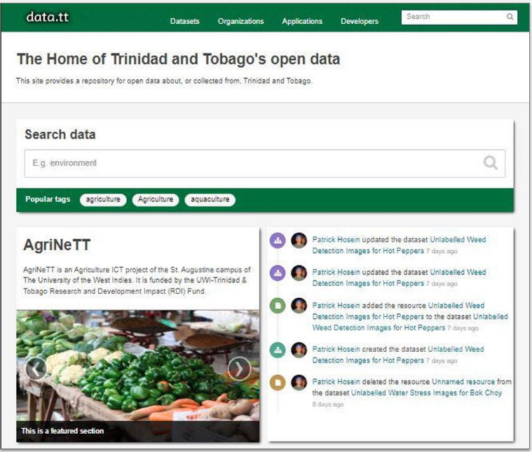
Platform for Data Access
Using the images that were collected and labelled, four data sets were uploaded to the repository data.tt. This is an online repository which we developed and is powered by an open source application, CKAN. This site provides open data to the general public for personal or academic use. All data sets available on this site were collected from or are directly related to Trinidad and Tobago. Collections of data sets are published under Organisations and can also be viewed by tags, groups, file formats and licences.

Slide 10
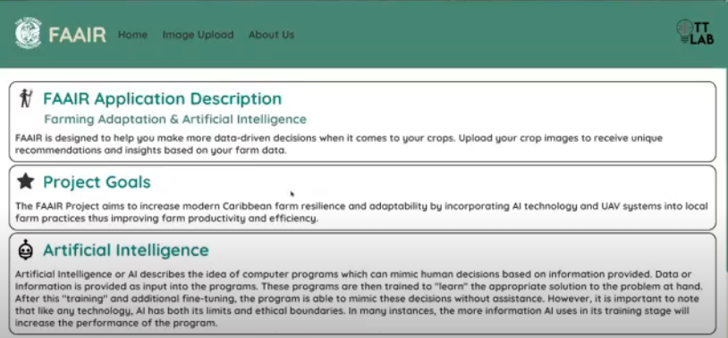
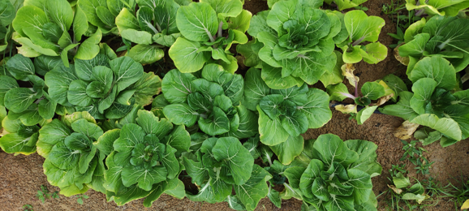
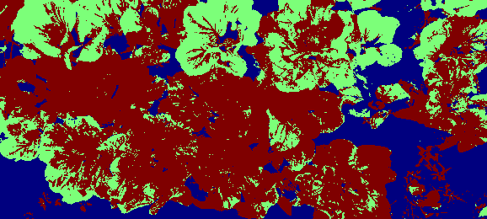
Applications Created
Using the data collected models were trained and a web application was created that did segmentation predictions on image data and supplied farmers with insights on areas of water stress indicated by the green colour .

Slide 11
Conclusion
Overall, the project will enable the real time and rapid assessment of smallholder crop and soil health and cover, using machine learning models. This will be deployed using Unmanned Aerial Vehicles, over a variety of landscapes and production systems characteristic of small island states. By generating landscape data, reducing reliance on post-processing expertise and expensive satellite imagery,the project will increase the adoption of AI for climate smart agriculture in the Caribbean.
FUTURE APPLICATIONS:
Detect Plant Disease
Estimate crop yields by calculating the expected yield of a crop in a specific area
Classify crop types e.g., sweet potato, cassava.
Classify Land cover and Land Use
Identify contaminants in crops and soils
Supporting Precision Agriculture (mention herbicide and pesticides reduction...)

